Slide 1
Human resources slide 1
Crowdfunding
Kickstarter
Group 2
Rohan D. Kamble
Karthik
Mahesh Gupta

Slide 2
Human resources slide 2
AGENDA
Introduction
KPI : Total Number of Projects based on outcome
Category
KPI : Total Number of Projects based on Locations
Category
KPI : Total Number of Projects based on Category
Category
KPI : Total Number of Projects based on Category
Category
KPI : Total Number of Projects created by Year , Quarter , Month
Tableau Dashboard
Category
Power BI Dashboard
Category
Excel Dashboard
SQL

Slide 3


Human resources slide 3
Crowdfunding
DATABASE
Crowdfunding is a method of raising capital by collecting small amounts of money from a large number of people, typically via the internet. It allows creators, entrepreneurs, and innovators to fund their projects or ventures without relying on traditional investors or financial institutions.
The dataset contains nearly for 4 lakh startup of information from 2009- 2019 from all over the world.
It allows to view an startup in detail .
startup status, goal amount , start and end date , Amount raised , category of startup , location and other details
Here are four tables with datasets which are inter-connected through common
fields
INTRODUCT
ION
Kickstarter
Kickstarter is one of the leading crowdfunding platforms, launched in 2009, that enables creators to bring their ideas to life by raising funds directly from backers. It is designed to help artists, inventors, and entrepreneurs fund a wide variety of projects—ranging from technology and design to music, films, and more..

Slide 4
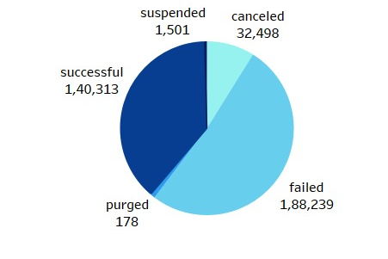
Human resources slide 4
Total Number of Projects Based on Outcome
This KPI measures the success rate of projects, comparing those that meet their funding goals to those that do not
Set Realistic Goals: Ensure your funding target aligns with your
project's needs and is achievable based on similar projects.
Enhance Project Page: Make your project page compelling with
high-quality visuals, a clear description, and engaging content.
A well-presented project is more likely to attract backers.
Offer Tiered Rewards: Provide rewards at various levels to encourage different types of backers to contribute.
Frequent Updates: Keep your backers engaged by sharing regular updates. Active communication increases trust and commitment

Slide 5
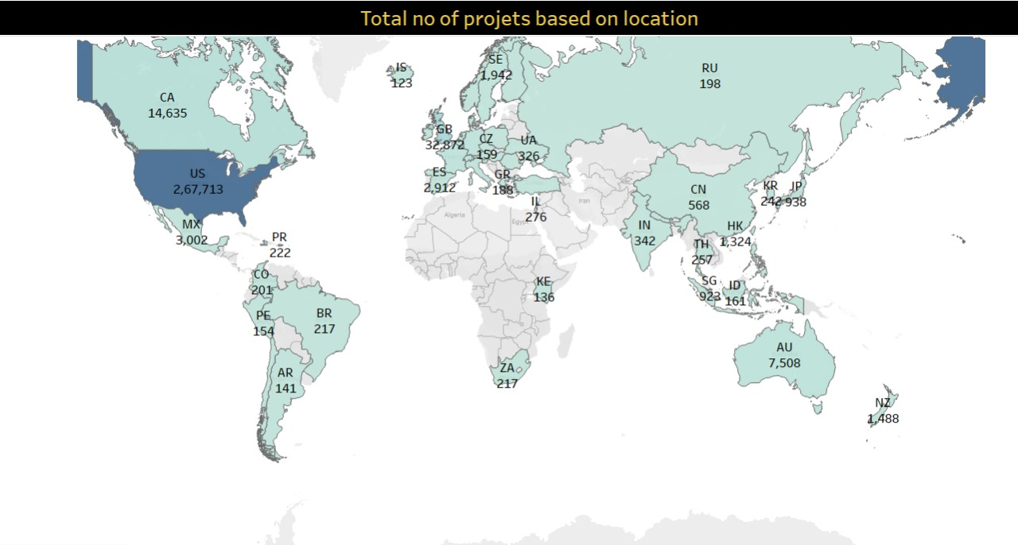
Human resources slide 5
Total Number of Projects Based on Locations
This KPI tracks the geographic distribution of projects on Kickstarter, showing which regions or countries have the most active campaigns
Target Emerging Markets :Consider promoting your campaign in regions with growing interest in crowdfunding but fewer active projects. Countries like India, Southeast Asia, and parts of Africa are potential growth areas.
Localized Marketing Efforts: Tailor your campaign page and marketing efforts to specific regions. Translate the page into local languages and highlight how the project aligns with regional interests..
Collaborate with Local Influencers: Partner with influencers or thought leaders in key regions to amplify your message and increase visibility

Slide 6
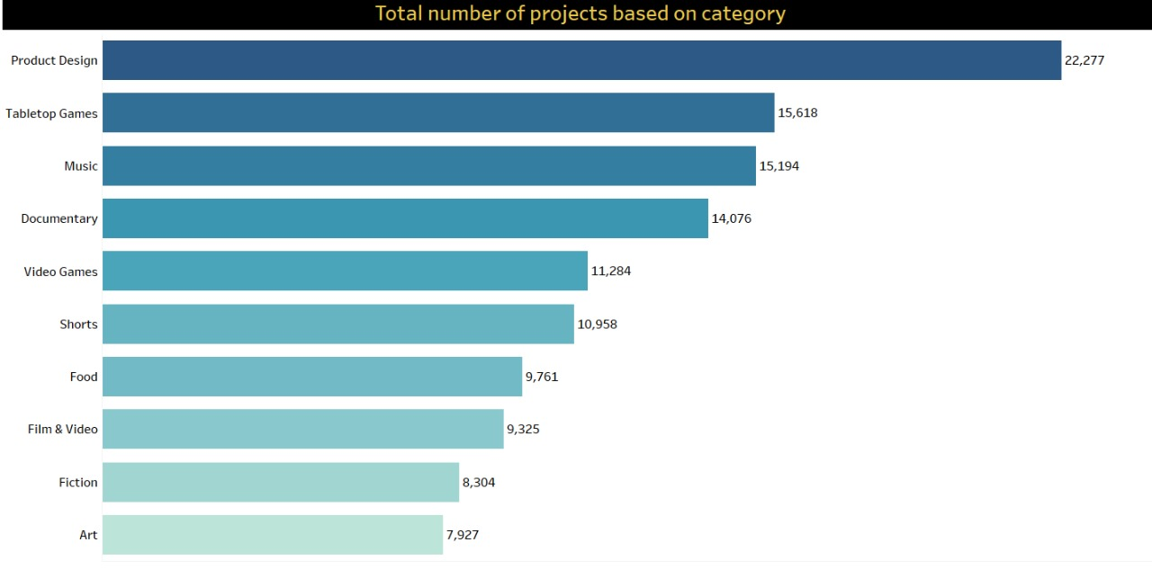
Human resources slide 6
Total Number of Projects Based on Category
This KPI shows how many projects are being launched across various categories
Analyze Market Trends: Stay updated on emerging trends within different categories. For instance, projects related to sustainability, health tech, or virtual reality are gaining traction.
Niche Projects: Identify underserved or niche categories and target them. By focusing on less competitive but growing areas, your project could stand out.
Unique Value Proposition: In competitive categories like tech or design, differentiate your project with innovative features or a unique angle to capture backers' attention.

Slide 7
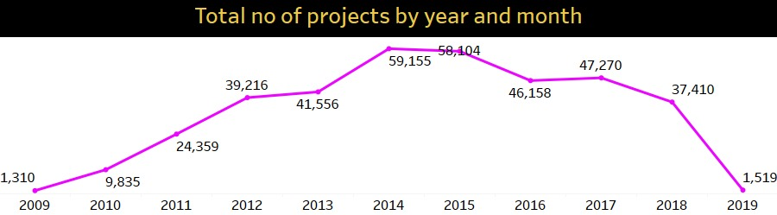
Human resources slide 7
Total Number of Projects Created by Year
This KPI tracks the number of projects launched within specific time periods, helping identify trends and seasonality
Time Campaign Launches Strategically: Launch during high-traffic periods when backers are more active, such as during holidays or major shopping seasons. Avoid launching during "crowded" times when many campaigns are live.
Seasonal Trends: Plan your campaign around seasonal interest. For example, certain categories like tech may see a spike in interest around major tech events or product launches.
Monitor Industry Events: Launch your project around industry-specific events (e.g., Comic-Con for comics, CES for tech) to tie into existing excitement and interest.
Plan Long-Term: Map out a yearly schedule for your project launches. Understanding the natural ebb and flow of the crowdfunding landscape will help you time your campaign for maximum success.

Slide 8

Human resources slide 7
Summarized facts
$ 4.27 B
38.35 %
80 Days
140 K
Amount Raised
Successful Project
Average Days
Backers
More than 4 Billion dollars funding raised over the period of time
Out of all, 38.35% projects were successful in raising funds
On average, 80 days is required to raise funds
Over the period, more than 140 thousand people successfully have invested in the startups.

Slide 9
Human resources slide 6
Challenges Faced
While creating visual and preparing projects
Creating visual for project based on location
Build relationship in SQL between Excel files
Converting epoch time into normal time
Handling Duplicate Values

Slide 10
Human resources slide 10
Lets dive into dashboards now
]

Slide 11
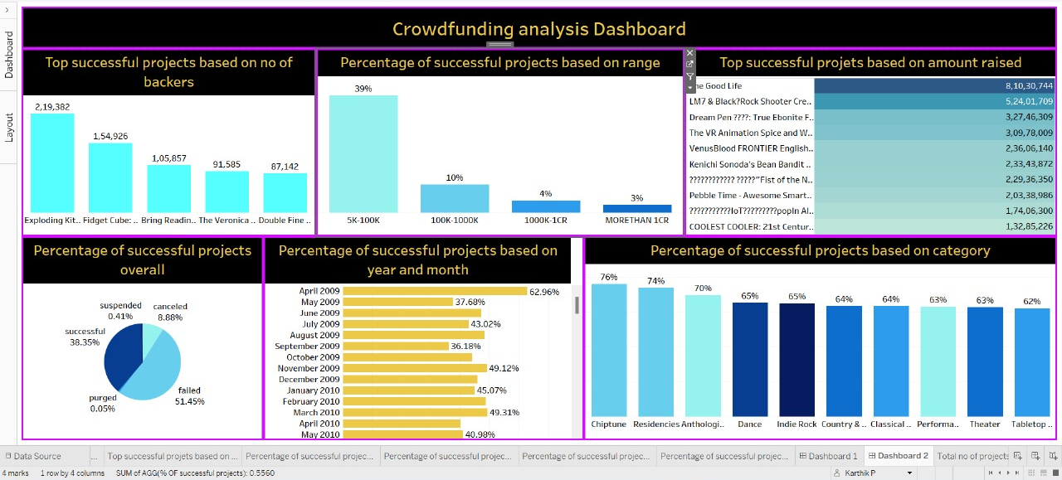
Human resources slide 10
Tableau Dashboard Part 1

Slide 12
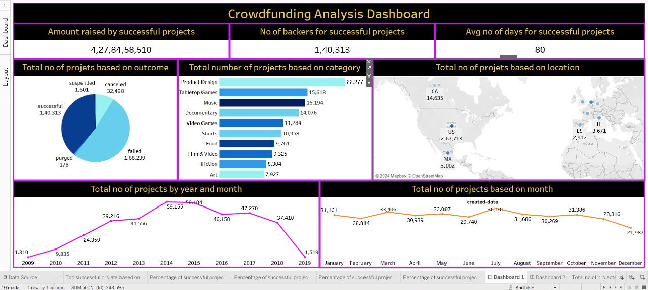
Human resources slide 10
Tableau Dashboard Part 2

Slide 13
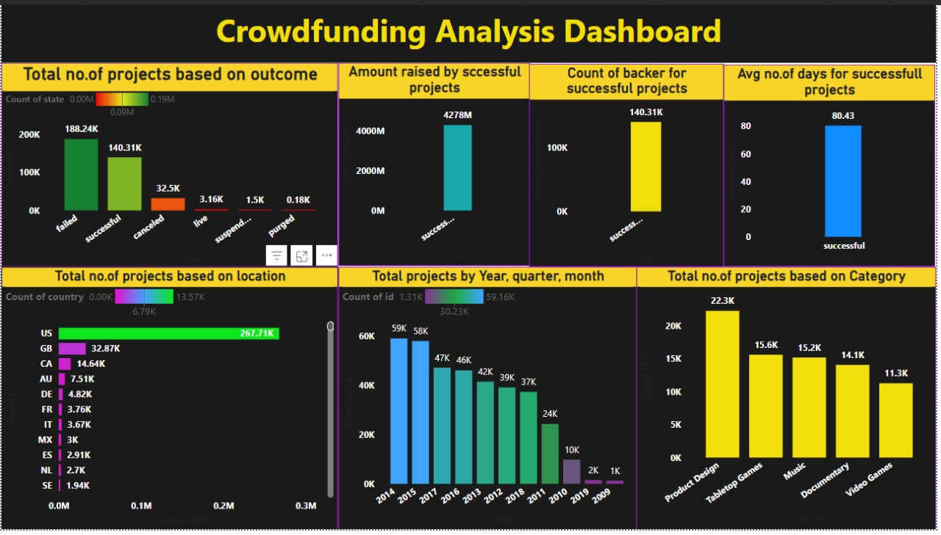
Human resources slide 10
Power BI Dashboard Part 1

Slide 14
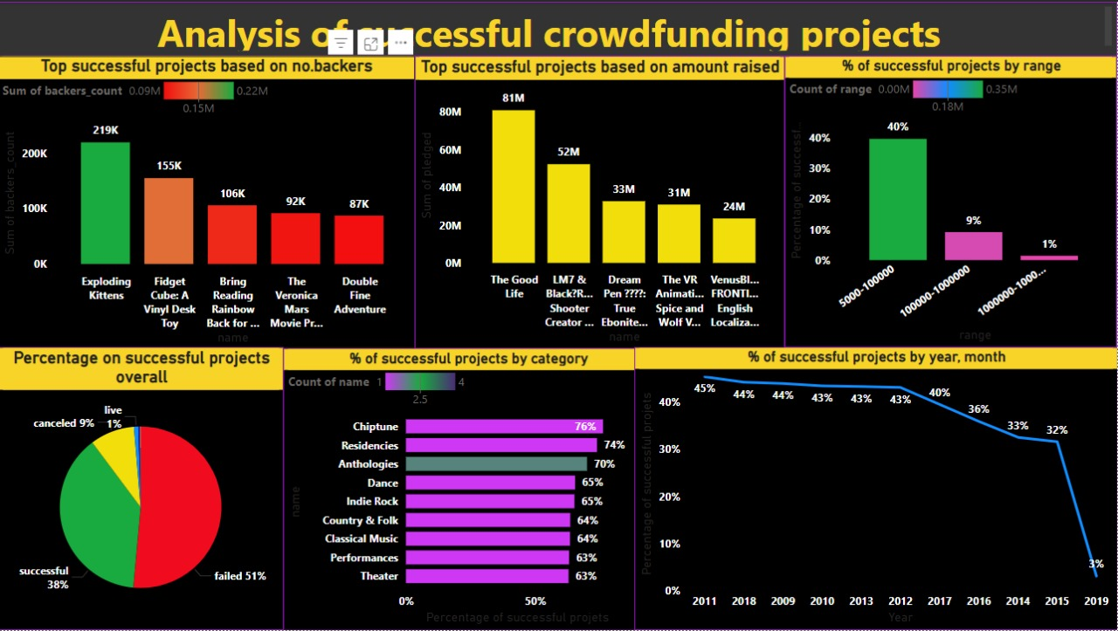
Human resources slide 10
Power BI Dashboard Part 2

Slide 15
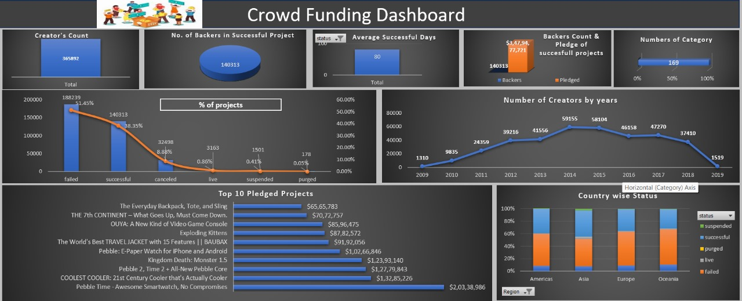
Human resources slide 10
Excel Dashboard Part 1

Slide 16
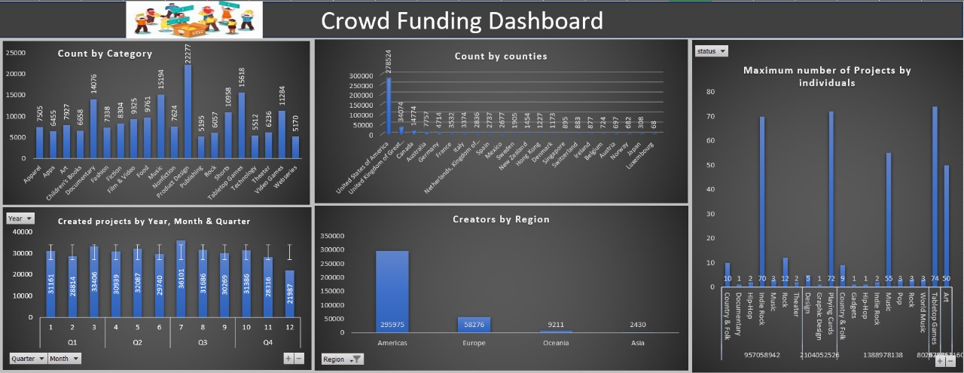
Human resources slide 10
Excel Dashboard Part 2

Slide 17
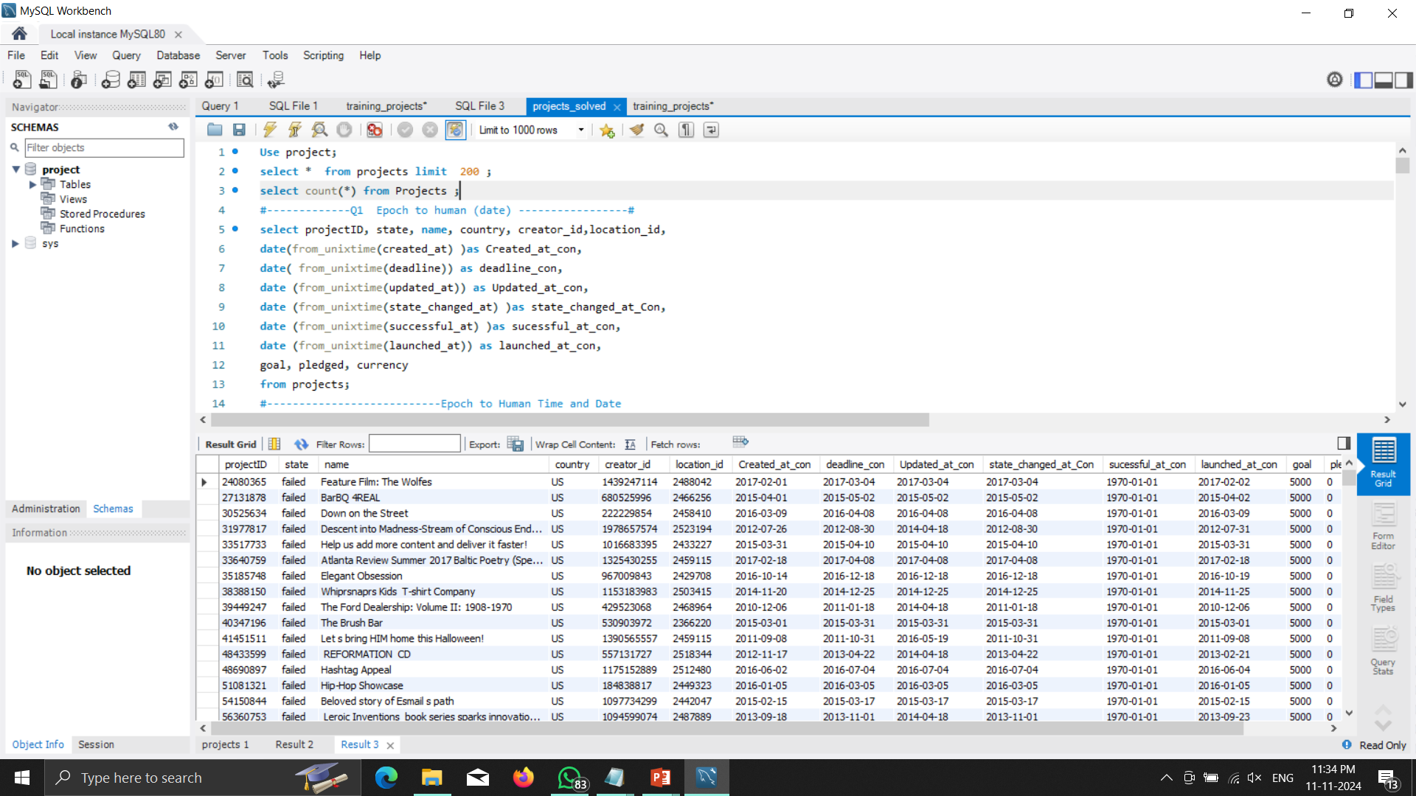
Human resources slide 10
SQL question 1

Slide 18
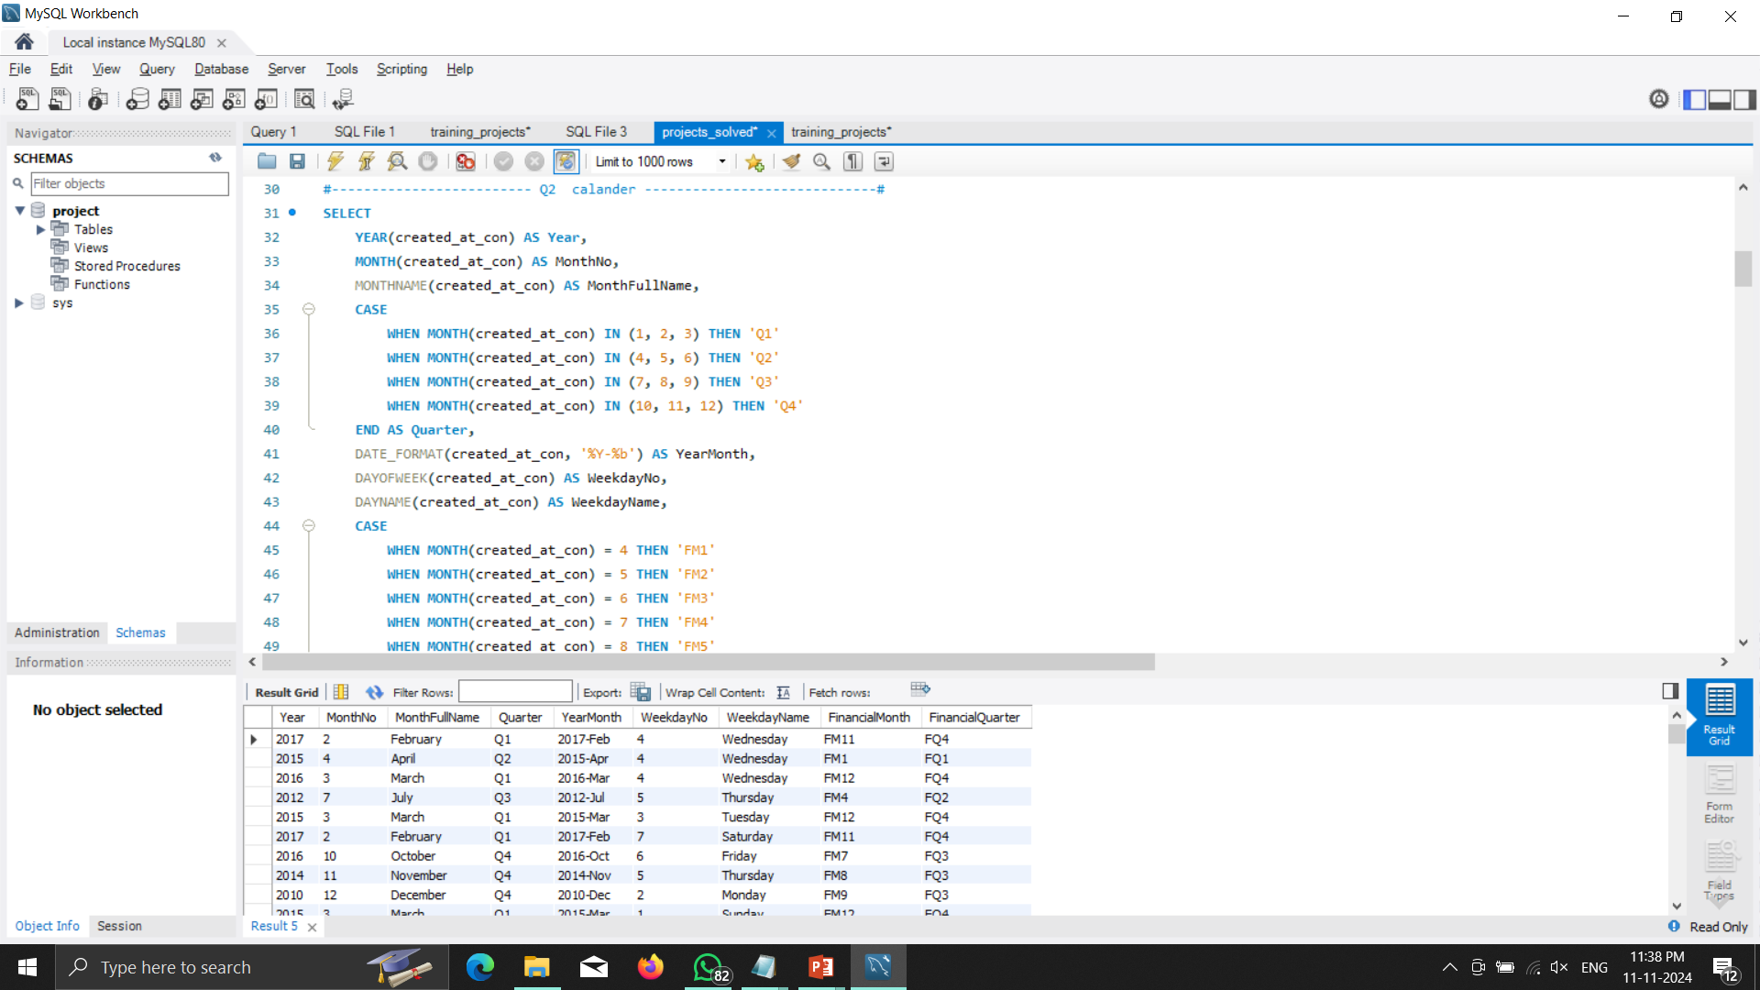
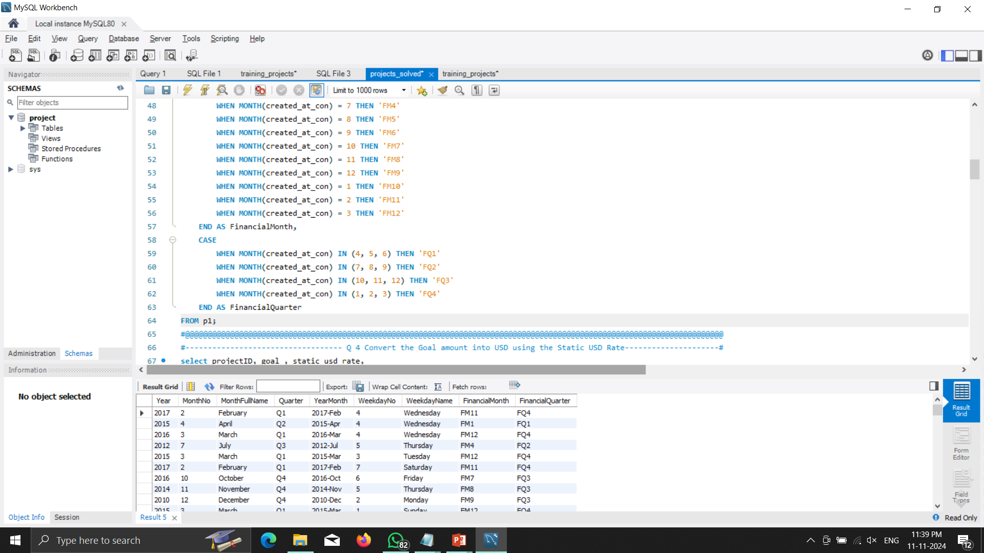
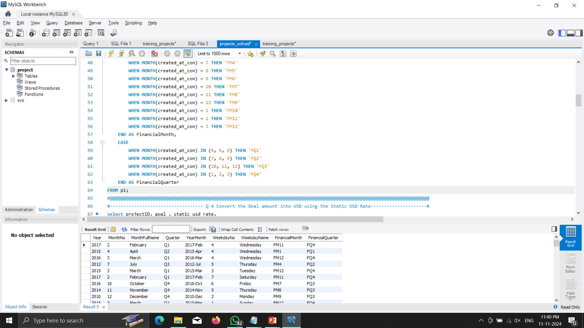
Human resources slide 10
SQL Calendar

Slide 19
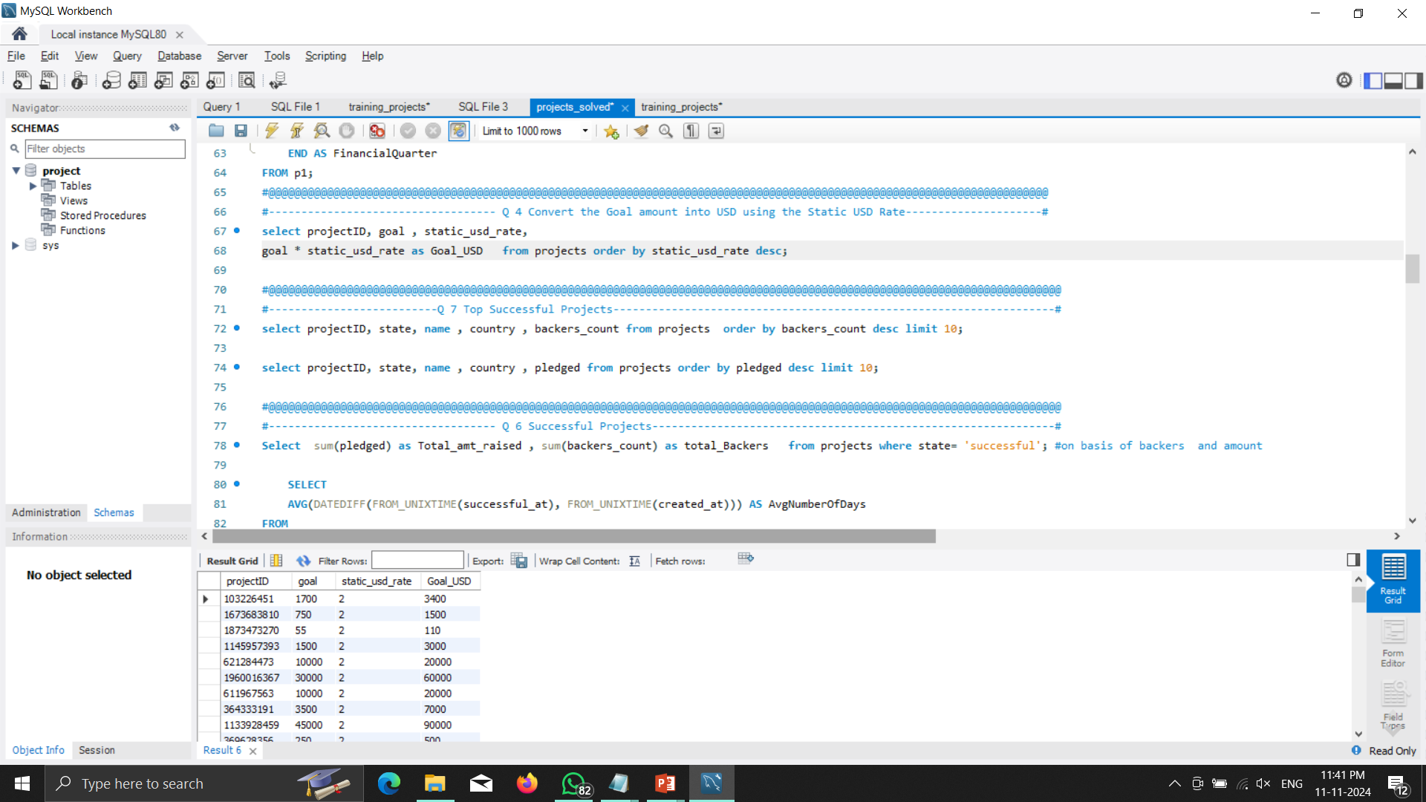
Human resources slide 10
SQL Converted Goal Amount

Slide 20
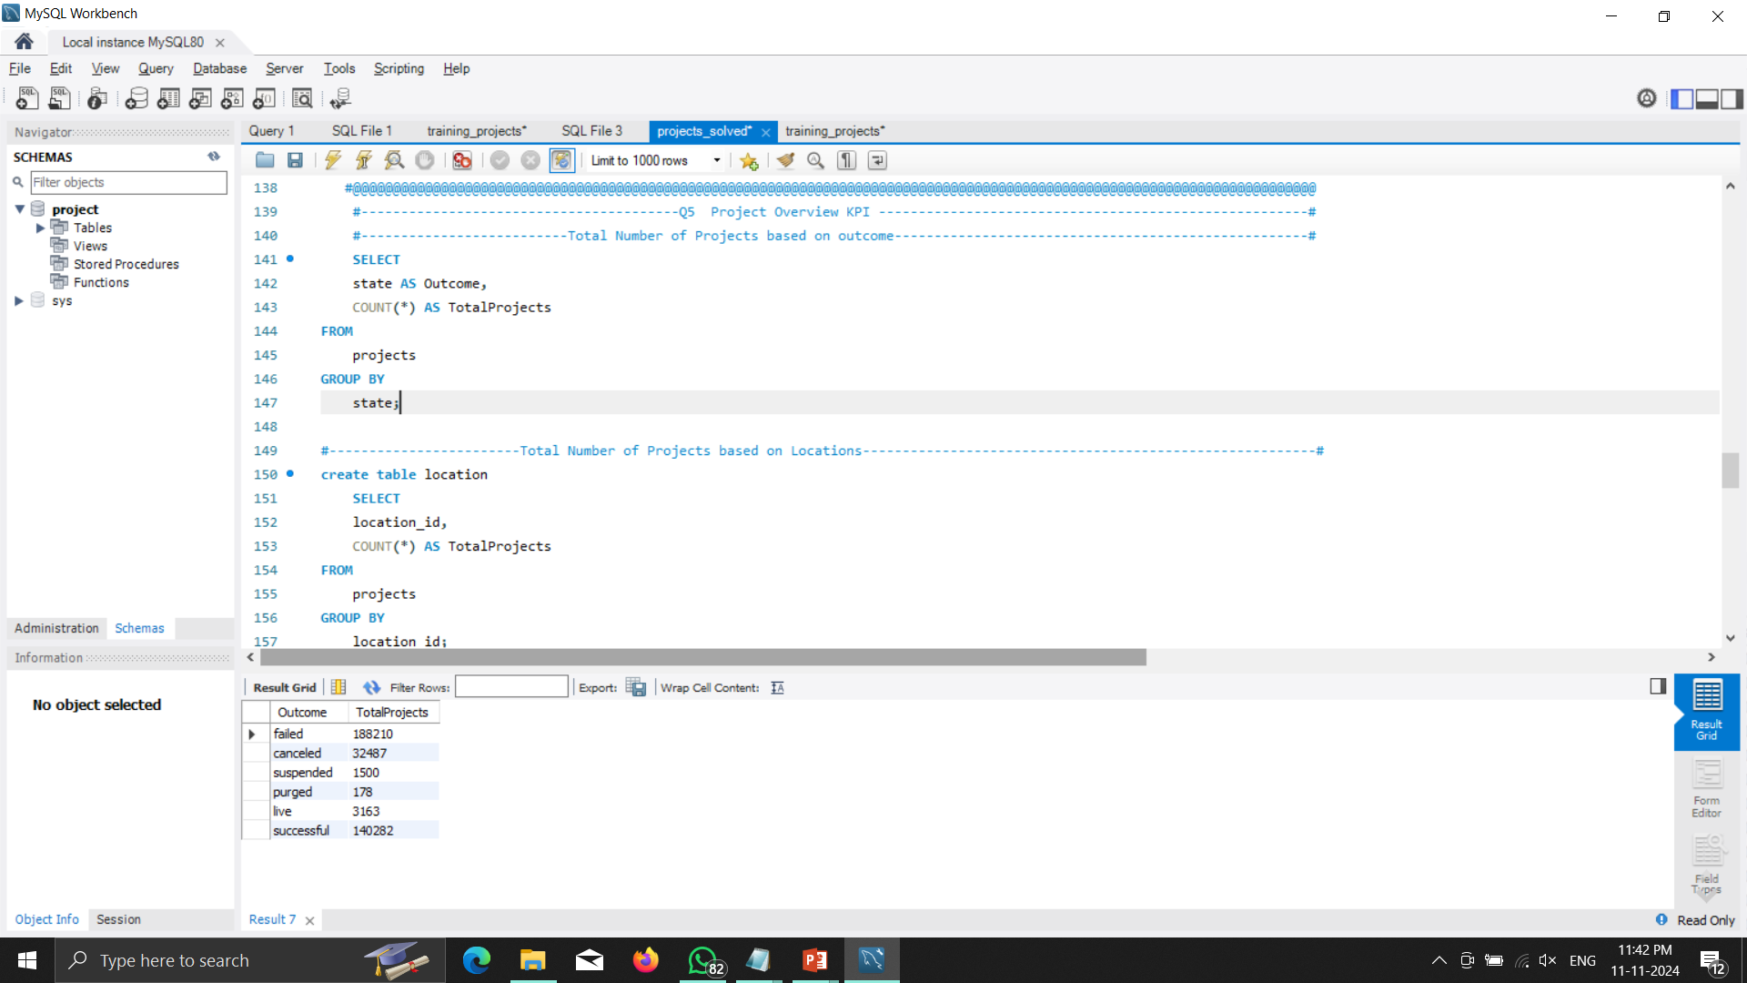
Human resources slide 10
SQL KPI

Slide 21
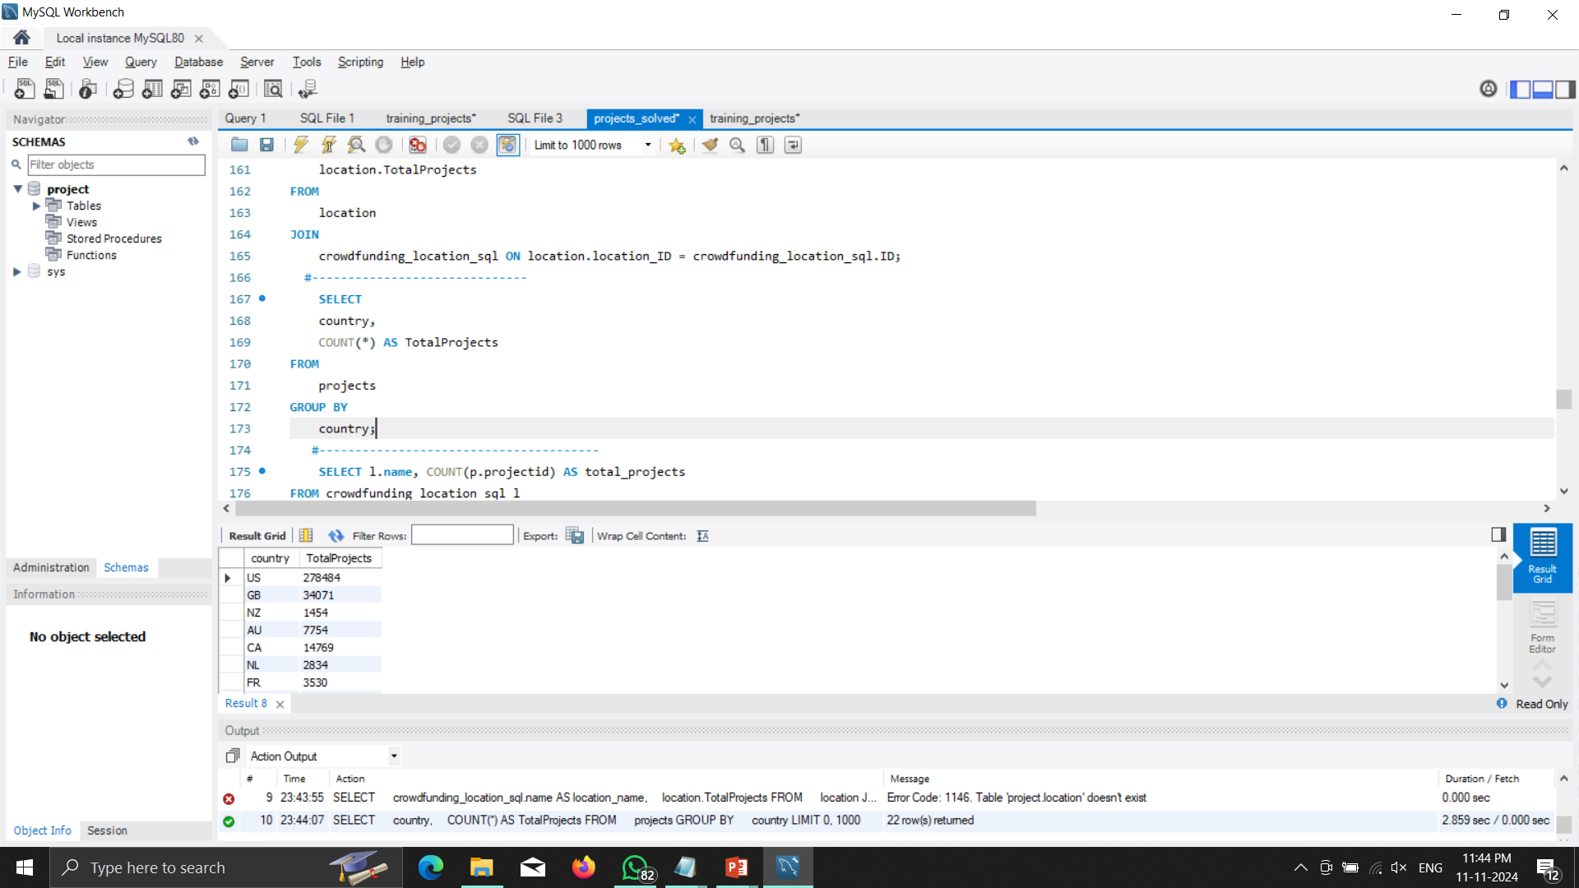
Human resources slide 10
SQL KPI

Slide 22
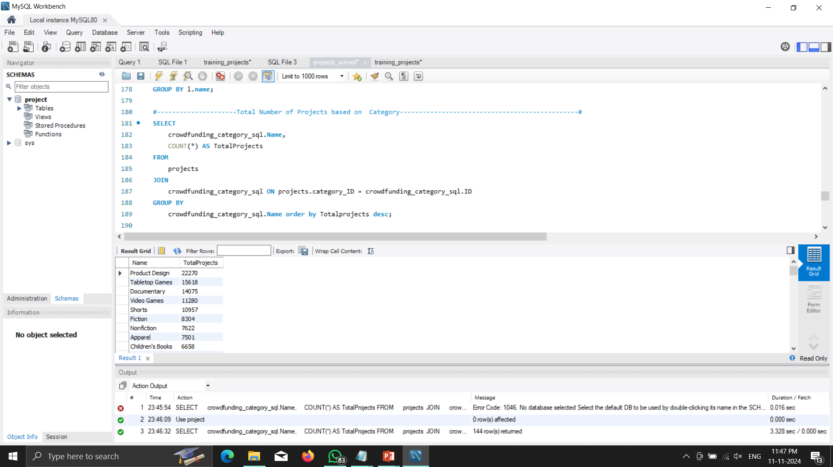
Human resources slide 10
SQL KPI

Slide 23
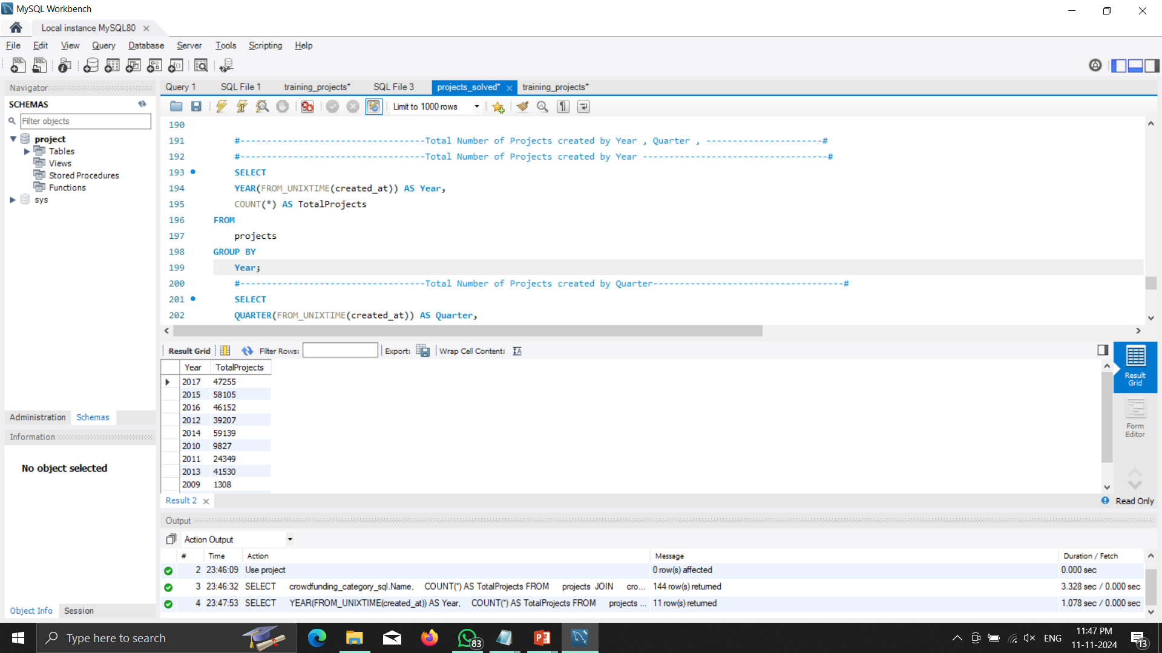
Human resources slide 10
SQL KPI

Slide 24
Human resources slide 10
SQL Question 5.4

Slide 25
Human resources slide 10
Thank You
.

